Slide 1

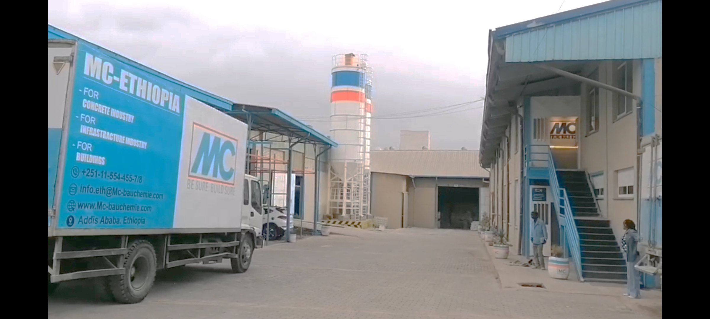
2024 HR Report
MC-Bauchemie Ethiopia

Slide 2
Table of content
Introduction
Organizational Charts
Strength, weakness, opportunity, Challenges
Area of improvement
Recommendation Target/2025
Stastical data
Conclusion

Slide 3
Introduction

Slide 4
Strength
Recruitment
Employee relation
Health Care & Medical Insurance
Grievance Handling

Slide 5
Weakness
Turnover
Lack of Technology
Communication Internal and External
Undefined KPIs

Slide 6
Opportunity
Performance Appraisal
HR Manual

Slide 7
Challenges
Employe Retention
Medical

Slide 8
Area of Improvement
Employe Training and Development
Annual employee medical expense
Performance review by the managers before the probation confirmation in order to tackle any unsatisfactory performance of new joiner

Slide 9
Recommendation
Employee retention strategy
Clear and effective communication internal and external

Slide 10
Stastical Data
Recruitment
Turnover
Employee year of service
Total work force as of 31th Dec 2024

Slide 11
Recruitment of the budget year

